Slide 1


DataBase Logic in Business Applications
Al.I. Cuza University of Iași
Faculty of Economics and Business Administration
Department of Accounting, Information Systems
and Statistics
De- and Post- Normalization of a Database Schema
By Marin Fotache & Co.

Slide 2
Notice
All the Oracle Data Modeler diagrams in this presentation are archived and can be downloaded at:
https://github.com/marinfotache/Database-Logic-in-Business-Applications/tree/master/04_DB%20Logical%20Design__Denormalization
Please follow the instructions in `readme.md` file

Slide 3
Denormalization
Introduced by Data Warehousing
Related (in many texbooks) to physical database design
The process of introducing controlled rendundancy is order to:
Improve the data access speed
Implement complex business rules, such as:
Invoices cannot have more than 10 rows (lines)
Customers for which accounts receivable is greater than 10000 lei are not allowed to buy other goods (until they pay the appropriate minimum amount)
A library reader can borrow, at a time, at most:
Three books if he is enrolled to an undergraduate programme
Five books if he is enrolled to an graduate programme
Six books if he is a Ph.D. student
Better control the user access
Keep record of some important transactions

Slide 4
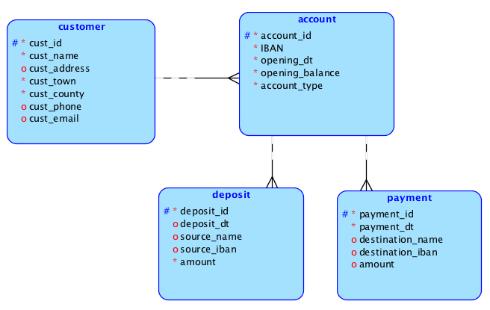
bank_cards_1 – Fully Normalized (Oversimplified) Schema – E-R

Slide 5
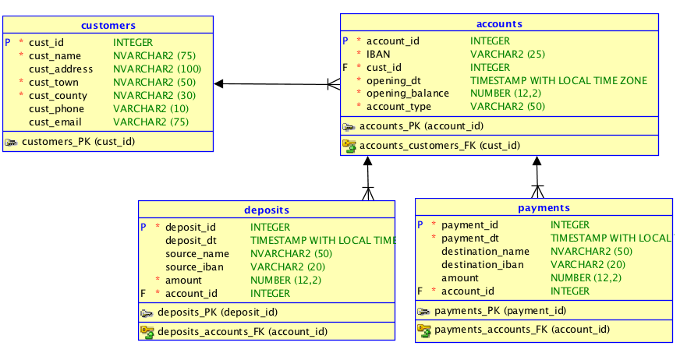
bank_cards_1 (Fully Normalized) Relational Diagram

Slide 6
bank_cards_1 Main Drawback
Any time an account balance is needed (e.g. to check if there is anough money to complete a payment), a huge processing power is required since the query is:
SELECT IBAN, Opening_Balance,
COALESCE(Total_Deposits, 0) AS Deposits,
COALESCE(Total_Payments, 0) AS Payments,
Opening_Balance + COALESCE(Total_Deposits, 0) –
COALESCE(Total_Payments, 0) AS Current_Balance
FROM accounts a
LEFT OUTER JOIN
(SELECT account_id, SUM(amount) AS Total_Deposits
FROM deposits
GROUP BY account_id) INCREASES
ON a.account_id = INCREASES.account_id
LEFT OUTER JOIN
(SELECT account_id, SUM(amount) AS Total_Payments
FROM payments
GROUP BY account_id) DECREASES
ON a.account_id = DECREASES.account_id

Slide 7
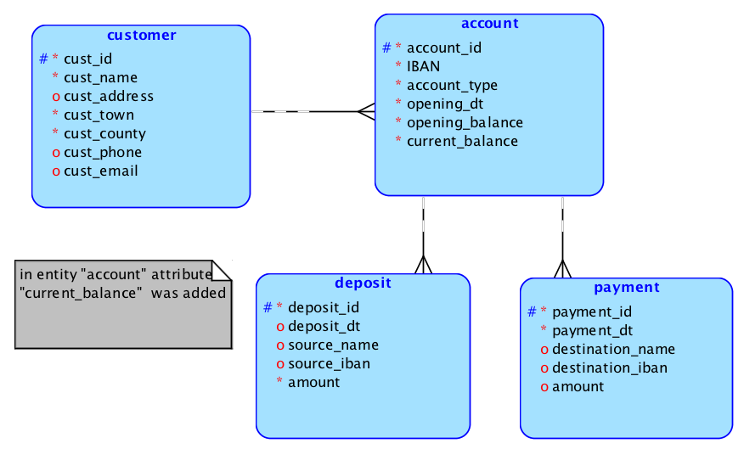
bank_cards_2 – Denormalized Schema E-R Diagram

Slide 8
Denormalizing sales Database
The main goals of de/post normalization of sales database are:
Temporal validity (see previous presentation)
Quicker access to information, assuming that some information are frequently required :
Invoice VAT (for financial reports/statements)
Invoice total amount (including VAT)
Amount received (payed) for each invoice
A better control for user access to some data
Implementing complex business rules using database logic (stored procedures)

Slide 9
sales_2 Database Schema Version
"Inherits" from previous solutions (sales_1_solution_x) attribute row_VAT as solution for temporal validity (see previous presentation)
Each product current VAT percent is stored with attribute current_vat_percent in entity product
Three denormalized attributes in class invoice:
Invoice_VAT
Invoice_amount (total amount, including VAT)
Amount_received (amunt paid by the customer) for each invoice
Denormalized attributes were chosen as they are required very frequently by various users (from departments of sales, accounting, manufacturing, finance)

Slide 10
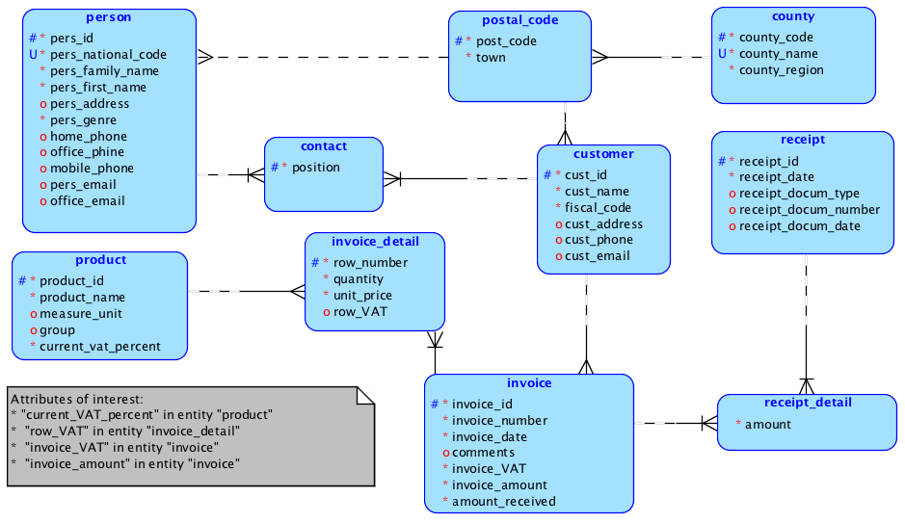
sales_2 E-R Diagram

Slide 11
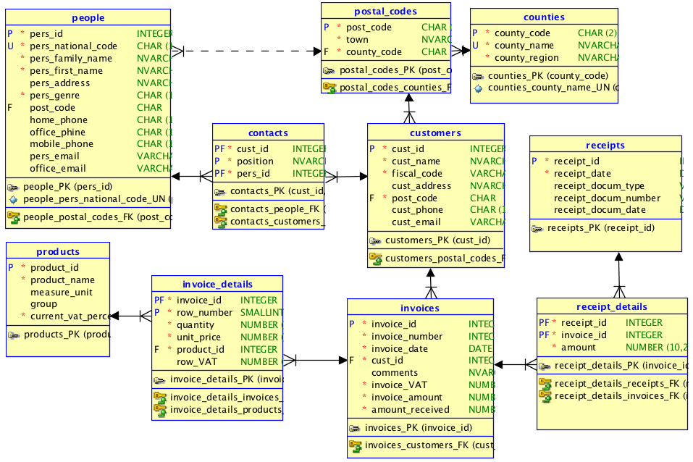
sales_2 Relational Diagram

Slide 12
sales_2 - Strengths & Limits
Strengths
Simplicity (relative fewer additional attributes)
Current VAT percents are available
Some of the previous VAT percerts are available through expression: row_VAT / (quantity * unit_price)
Simple access (no join required) to invoice amount and VAT
Limits
There is no way of finding all the previous VAT percents for the sold product
It is impossible to find out the exact date when VAT percents have been changed during the years

Slide 13
sales_3 Database Schema Version
Based on sales_2 version
Solves two "historical" problems:
Keep track of all products VAT percents during database lifetime
Customer contacts filled positions
New attribute: amount_paid in entity receipt
New entities
former_contact
former_vat_percent
Renamed entity: from contact to current_contact

Slide 14
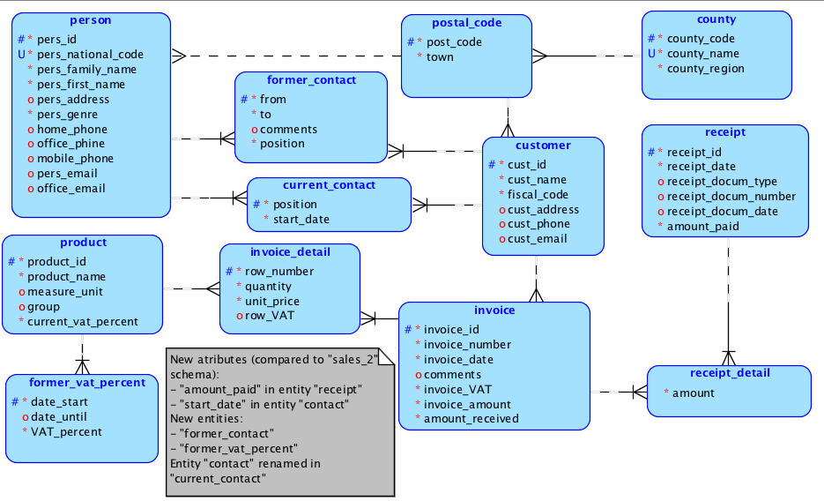
sales_3 E-R Diagram

Slide 15
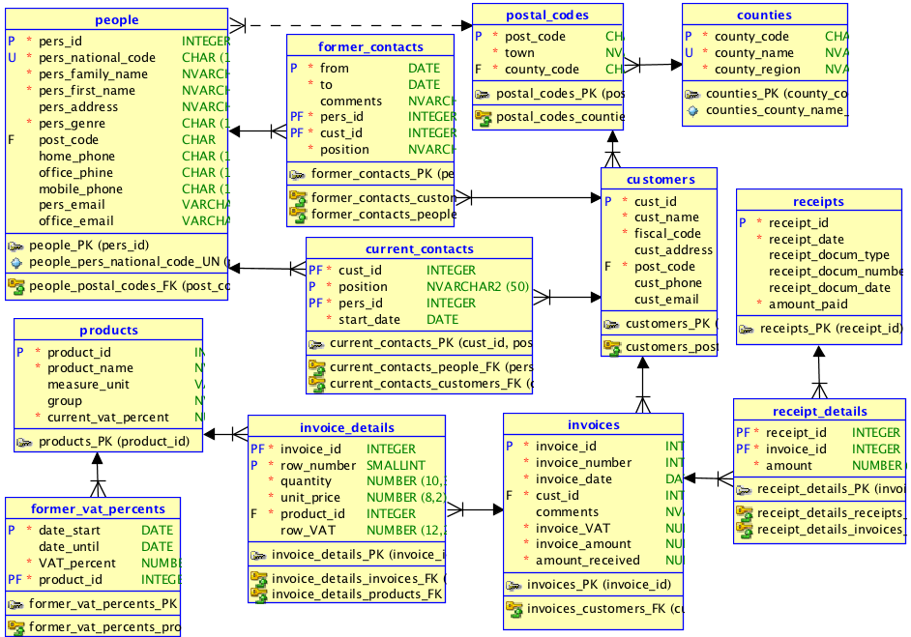
sales_3 Relational Diagram

Slide 16
sales_3 - Strengths & Limits
Strengths
All products current VAT percent is available
VAT percent history is recorded
Simple access to important data about invoices
Invoice amount (still) receivable is available without joins
Limits
New attributes/tables (schema becomes more difficult to read)
Dangers to database validity (if denormalized computed attributes are not synchronized properly with source data) – all these problems can be overcomed

Slide 17
Other (|De|Post)-Normalization Issues
New entities for making schema more realistic (closer to real world)
cancelled_invoice
refusal
refusal_product
New attribute related to de-normalization:
amount_refused in entity invoice
New attributes non-related to de-normalization:
is_closed in entity invoice
invoice_status in entity invoice
New attributes for implementing (using triggers) business rules
current_balance in entity customer (no more sales to customers with a current_balance greater than 120000)
n_of_rows in entity invoice (invoices cannot exceeds 10 rows/lines)

Slide 18
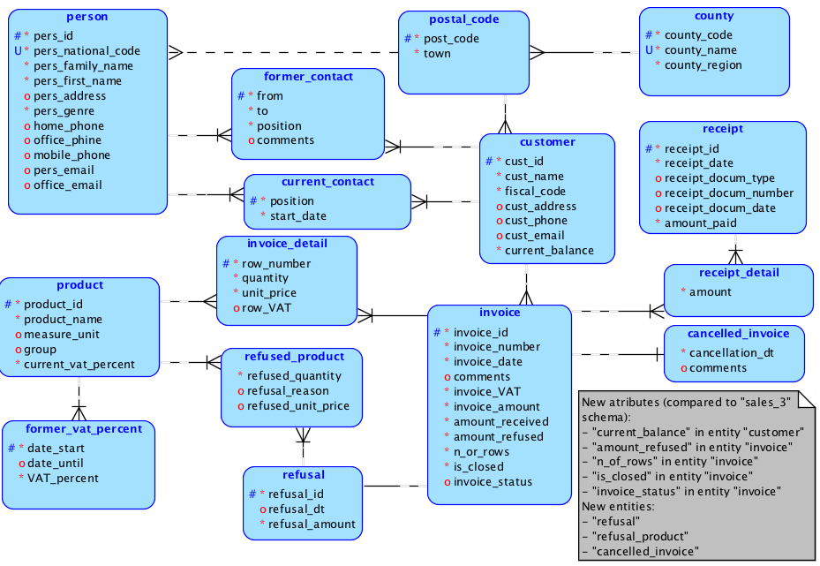
sales_4 E-R Diagram

Slide 19
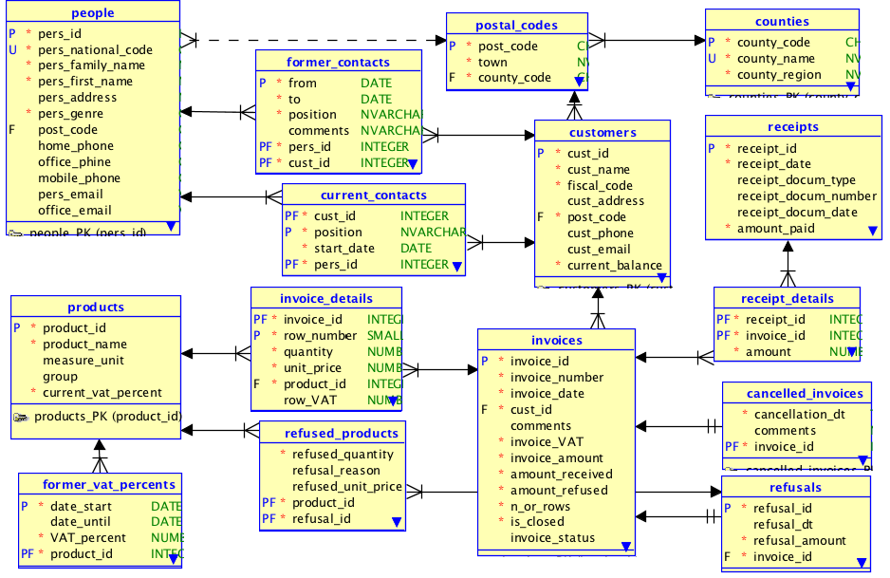
sales_4 Relational Diagram

Slide 20
Recap: What We Achieved With sales_4 Database Schema
Relevance:
Table cancelled_invoices (now a cancelled invoice will not count when computing sales, customer debts, etc.)
Tables refusals and refused_products (refusal amount will be sustracted from accounts receivable, customer debts, etc.)
Attribute invoices.status (give possibility of signalling special situations such as invoice customer bankruptcy or the fact that delivery did not reach the destination/customer because of an accident)
Validity over time:
Attribute invoice_details.row_vat (now every invoice amount will be computed only with this attibutes, and not by a join with table products)
Attribute current_contacts.start_date
Track evolution of:
Contacts (table former_contacts)
VAT percents (table former_vat_percents)

Slide 21
Recap: What We Achieved With sales_4 Database Schema (cont.)
Speed:
Attribute customers.current_balance
Attribute receipts.amount_paid
Attribute invoices.invoice_vat
Attribute invoices.invoice_amount
Attribute invoices.amount_received
Attribute invoices.amount_refused
Support for Business Rules implementation:
Attribute invoices.is_closed (now we can prohibit any update of closed invoices; n.b.: an invoice is closed after sending to the customers/banks; a closed invoice cannot be updated, but only cancelled)
Attribute invoices.n_of_rows (this might simplify the implementation of a business rule like: the maximum allowed invoice number of rows is 10)
Attribute customers.current_balance (useful for speed, but also for implementing a rule such as: "No more sales to customers with a current balance greater than 120000")

Slide 22
Concerns About sales_4 Database Schema
Data integrity for calculated attributes: how to be sure that, for example, invoices.invoice_amount is always identical with SUM(invoice_details.quantity * invoice_details.unit_price + invoice_details.row_VAT) for every invoice in the database ?
How to avoid explosion of workload for data entry guys:
When a contact change or end his customer position, he must be moved from table contacts into table former_contacts
Similarly, when VAT percetages change, table former_vat_percents_must also be updated
All the speed-improvement attributes must be synchonized with source data
How to forbid direct updating of derivated (denormalized) attributes, that is derivated attributes updated that do not come from changes in source data ?
How to implement business rules using denormalized (redundant) attributes such as those already presented?
What is the extent of business rules to be implemented in terms of complexity, resource needed, etc.
Two answers :
Triggers
Scheduler
(see also presentations and courses in a couple of weeks)

Slide 23
Over-De-Normalization
Databases can contain lots of denormalized tables, according to the required information (reporting, data analysis)
In this respect Databases become quasi-Data Warehouses
Main strengths:
Availability of information
Costs (no need for costly Data Warehouse solutions)
Information is always up-to-date
Main weaknesses:
No richness of Data Warehouding ETL (Extract-Transform-Load) tools
Additionaly resources needed (storage, processing power, database adminstration)
sales_5 version
Inherits all sales_4 schema tables and attributes
Three additional aggregate tables:
Months – contains montly sales, received, refusals, and cancellation amounts
Product_monthly_stats – aggregates above (described in table months) montly information about each product
Product_monthly_stats – aggregates above (described in table months) montly information about each product

Slide 24
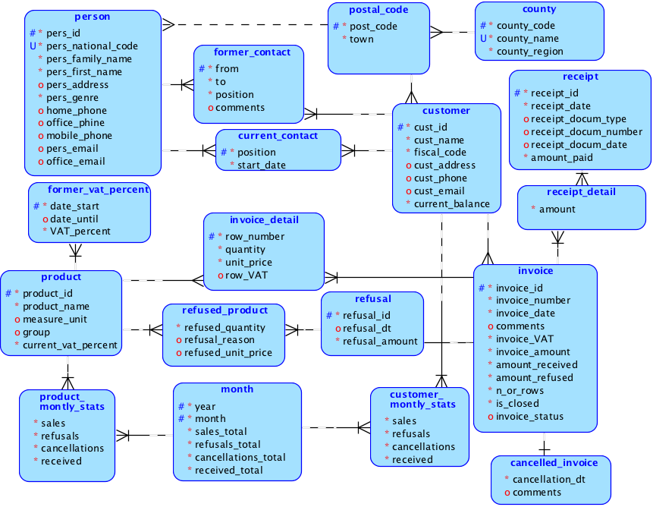
sales_5

Slide 25
univ_info_sys_2 De- & Post- Normalisation lecture discussion
Given this schema (see next slide), what would entities and relatioships would you add, modify or remove in order to provide:
Revelance (adaptation to the academic real-world processes and transactions)
Temporal validity
Improved speed
- Support for Business Rules implementation

Slide 26
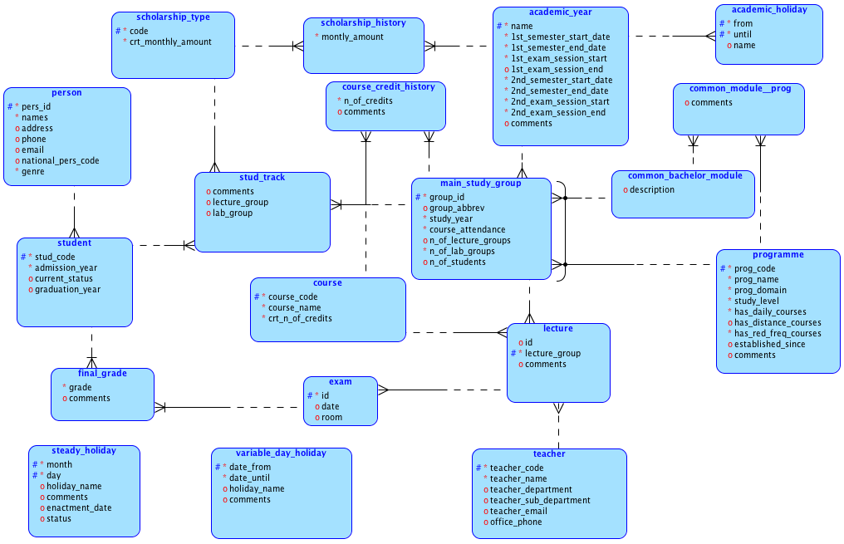
univ_info_sys_2 E-R Diagram

Slide 27
A Few Useful Resources on De-Normalization
Fotache 2005 (in Romanian)
https://github.com/marinfotache/Database-Logic-in-Business-Applications/blob/master/Proiectarea%20bazelor%20de%20date.%20Normalizare%20si%20post-normalizare%202005/PBD2005_Cap09_Denormalizare.pdf
What is Database Denormalization (2021)
https://www.youtube.com/watch?v=T3cx09FINuU
Database Normalization - Denormalization | Database Tutorial 6o
https://www.youtube.com/watch?v=sGJgeO3kpzI
Road to Denormalization
https://www.youtube.com/watch?v=sDdoQGSQCEY
Tutorials - Relational Database Fundamentals 6/5 Denormalization
https://www.youtube.com/watch?v=I1qTmHad8Ts&index=22&list=PLhwiWaeTESev_ikFYJmneK26jYXoqepxR
Ch 5 Denormalization
https://www.youtube.com/watch?v=EMhs0VddRJM

